Slide 1


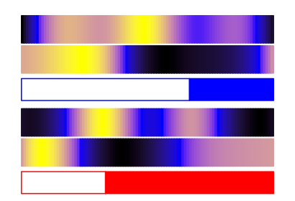
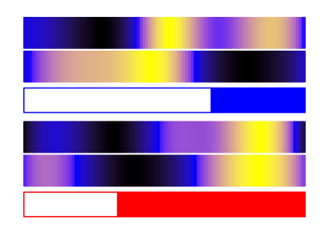
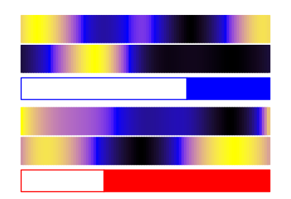
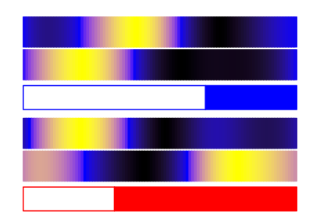
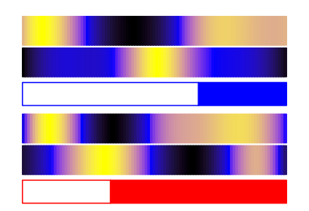
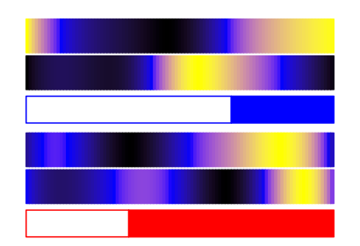
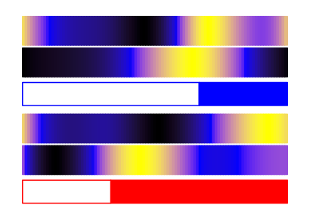
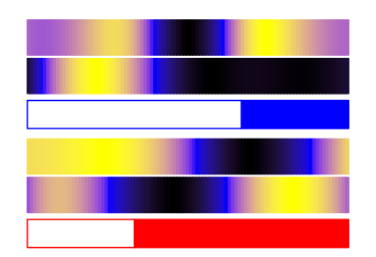
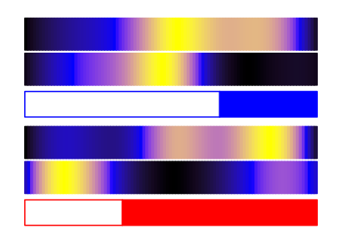
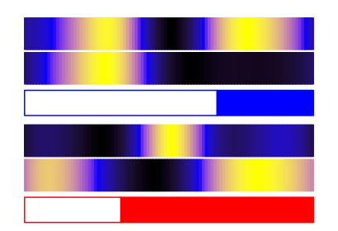
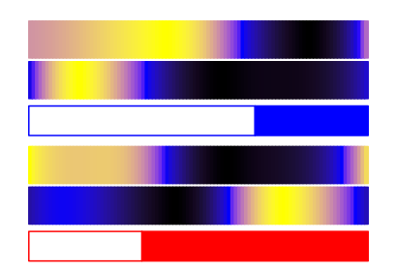
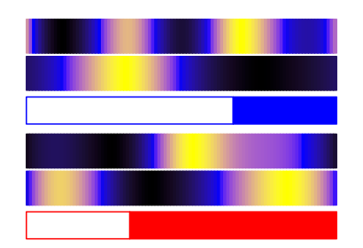
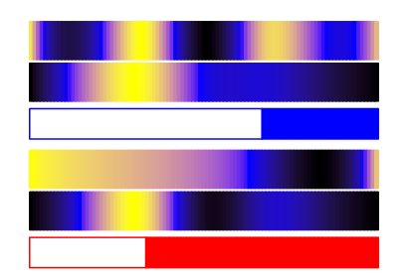
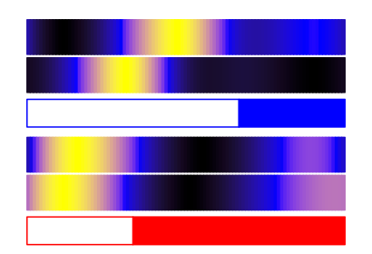
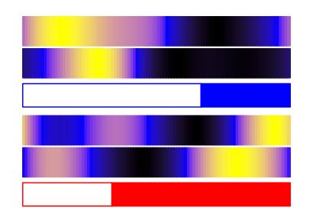
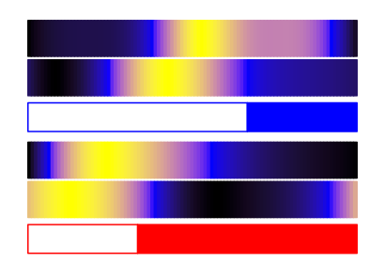
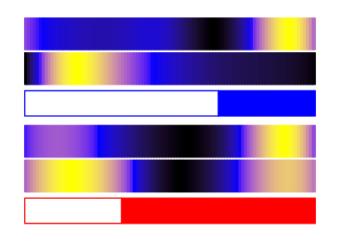
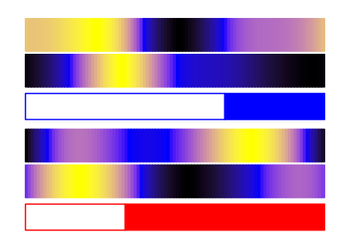
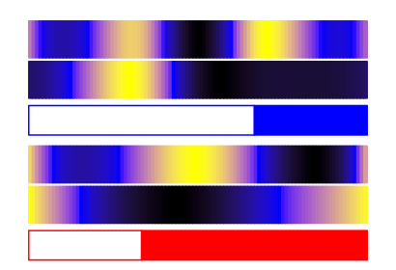
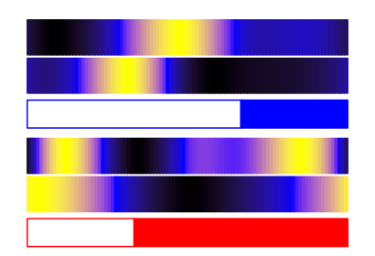
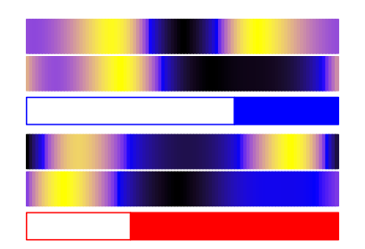
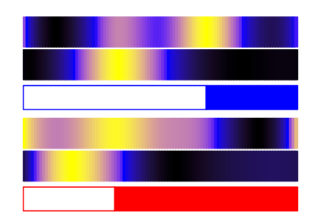
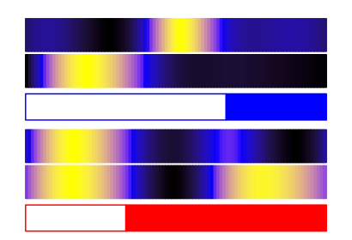
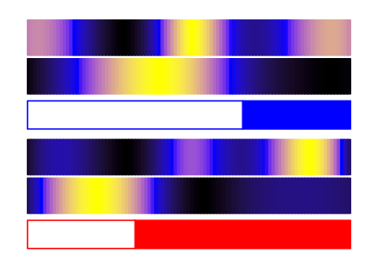
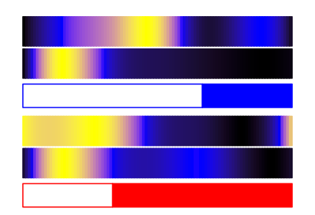
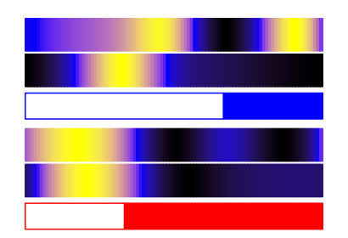
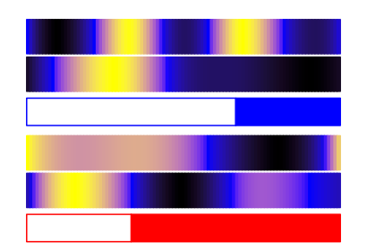
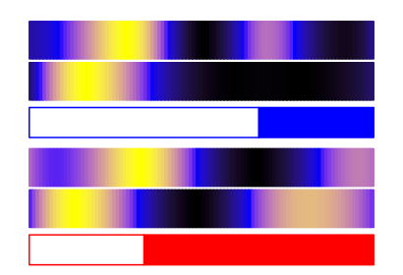
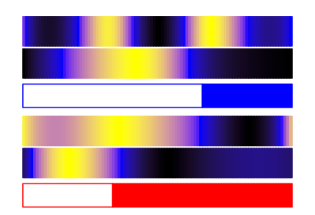
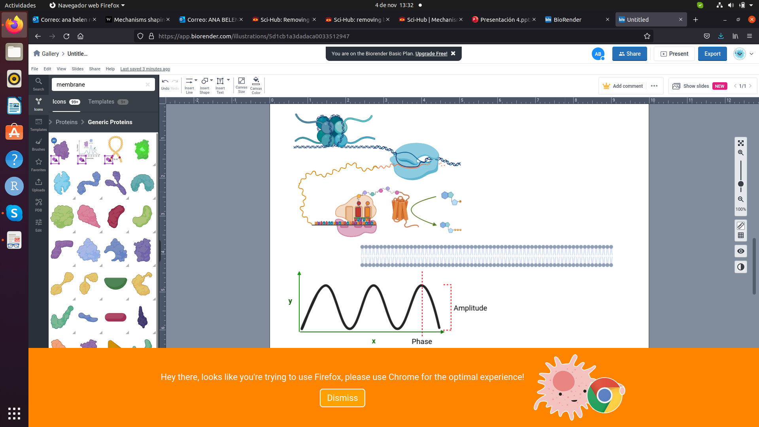
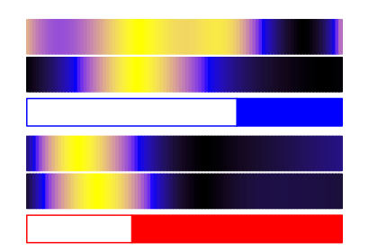
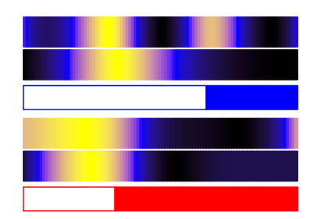
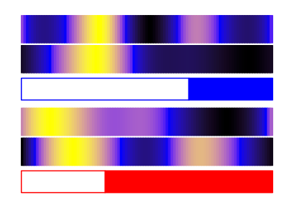
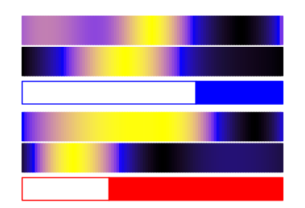
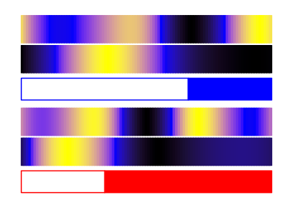
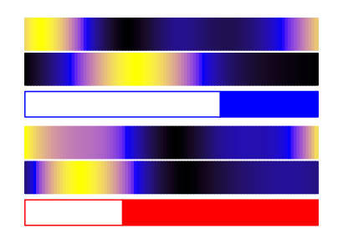
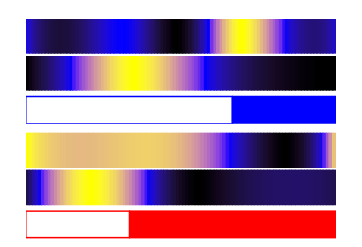
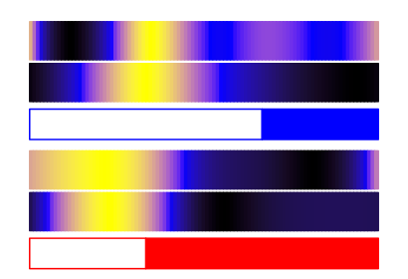
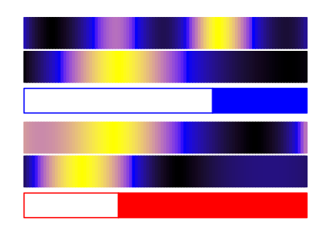
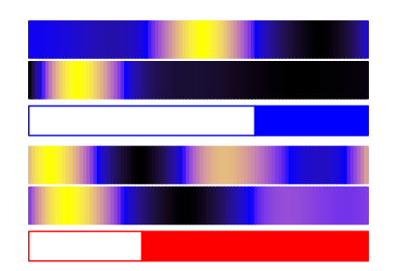
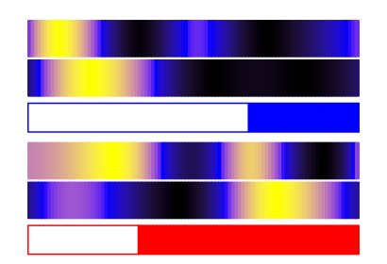
Protein LD
low
high
(A)
Transcript LD
Amylopectin
Protein SD
Starch
Granule
Transcript SD
F6P
TRK
E4P
FBA
S1,7P
Amylose
ISA
Maltodextrin
AMY
Maltose
FBPase
DHAP
SBPase
SBE
S7P
F1,6P
TPI
TRK
SSS
Starch Metabolism
FBA
X5P
R5P
GBSS
DHAP
RPE
RPI
TPI
ATP
RuP
ADPG
APS
G1P
PGM
G6P
PGI
F6P
FBPase
F1,6P
FBA
GAP
Calvin Cycle
APL
DHAP
PRK
NADP⁺
GAPDHA
ADP
RuBP
CO₂
GAPDHB
1,3BPG
RBCS
NADPH
PGK
3PGA
NADP⁺ + H⁺
ADP
ATP
H⁺
ADP + Pi
FNR
e⁻
ATPD
Stroma
LHCB5
Fd
H⁺
PsaD
PsaE
ATPG
e⁻
Psb27B
PQ
e⁻
PetE
PetF
PsaG
ATPC
PsaL
LHCSR
PetC
PsaH
Lumen
2H₂O
PsbO
PsbP
PsbQ
2O₂ + 4H⁺
e⁻
Pc
e⁻
PsaN
H⁺
H⁺
PsaF
ATP Synthase
PSII
Cyt b6f
PSI
Transcript LD
Photosystem II
(B)
PsbO - ostta14g00150
Transcript SD
Protein LD
Protein SD
PsbP - ostta14g02630
PsbQ - ostta16g01620
LHCB5 - ostta14g00065
Psb27B - ostta12g01970
LHCSR - ostta05g01780
Transcript LD
Calvin Cycle
Cytochrome b6f
RBCS - ostta18g001880
Transcript SD
Protein LD
Protein SD
Transcript LD
Transcript SD
Protein LD
Protein SD
PGK - ostta06g00700
PetC - ostta01g06610
GAPDHA - ostta01g01560
PetE - ostta09g04240
GAPDHB - ostta10g03420
PetF - ostta17g00310
TPI - ostta09g00120
FBA - ostta01g03040
Photosystem I
FBPase - ostta14g01010
SBPase - ostta03g05500
PsaD - ostta15g02670
Transcript LD
Transcript SD
Protein LD
Protein SD
RPI - ostta05g04130
PsaE - ostta02g03860
RPE - ostta06g01650
PsaG - ostta05g00800
PRK - ostta04g02740
PsaL - ostta02g00580
Starch Metabolism
PsaH - ostta15g00990
Transcript LD
Transcript SD
Protein LD
Protein SD
PsaN - ostta06g00250
PGI - ostta11g02780
PsaF - ostta04g01790
PGM - ostta06g02930
Fd - ostta17g00310
APL - ostta07g03440
FNR - ostta18g01250
APS - ostta07g03070
ATP Synthase
GBSS - ostta06g02940
Transcript LD
Transcript SD
Protein LD
Protein SD
SSS2 - ostta16g02480
ATPC - ostta01g03770
SBE - ostta03g00870
ATPD - ostta07g01350
ISA - ostta03g00870
ATPG - ostta09g01080
AMY - ostta10g00260

Slide 2



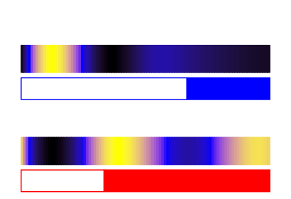


















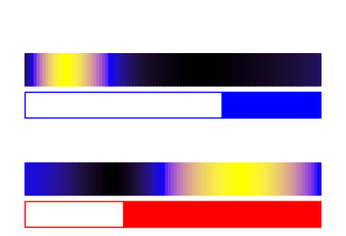





Pyruvate
Protein LD
low
high
(A)
GAP
Transcript LD
Protein SD
DXS
Transcript SD
Neoxanthin
DPX
Uriolide
NXS
DXR
MEP
Violaxanthin
CMS
Micromonal
VDE
ZEP
CDP-ME
CMK
CDP-MEP
Dihydrolutein
Prasinoxanthin
Antheraxanthin
MCS
VDE
ZEP
MEcPP
HDS
HMB-PP
Lutein
Zeaxanthin
HDR
εCH
βCH
IPP
DMAPP
βCH
GPPS
GPPS
α-carotene
β-carotene
GPP
LCYε/β
GGPPS
GGPP
PSY
Phytoene
PDS
ζ-carotene
ZDS
Lycopene
(B)
Transcript LD
Transcript SD
Protein LD
Protein SD
(C)
DXS - ostta02g01730
α-carotene
DXR - ostta04g03270
dihydrolutein
CMS - ostta07g03570
α branch
lutein
MEP
Pathway
CMK - ostta16g01910
prasinoxanthin
MCS - ostta11g00050
micromonal
HDS - ostta09g00960
uriolide
HDS - ostta09g00960
β-carotene
HDR - ostta08g01180
GPPS - ostta04g03170
β branch
zeaxanthin
GGPPS - ostta12g01280
antheraxanthin
PSY - ostta05g03530
violaxanthin
PDS - ostta10g02860
neoxanthin
Carotenogenesis Pathway
ZDS - ostta16g00590
LCYε/β - ostta14g00700
βCH - ostta13g02440
ZEP - ostta16g00670
VDE - ostta16g00660
NXS - ostta03g05610
εCH - ostta09g02540
α branch

Slide 3
















(A)
G1 Phase
S Phase
G2 Phase
% of Cells
% of Cells
% of Cells
G1
S
G2|M
G1
S
G2|M
G1
S
G1
S
G2|M
G1
S
G2|M
G1
S
G1
S
G2|M
G1
S
G2|M
G1
S
G1
S
G2|M
G1
S
G2|M
G1
S
G2|M
G1
S
G2|M
G1
S
G2|M
G1
S
G2|M
G1
S
G2|M
G1
S
G2|M
G1
S
G2|M
(B)
LD G1 Phase
LD G2 Phase
G1 Phase
Cells
G2 Phase
Cells
(G)
G1 Phase
Proteins
G2 Phase
Proteins
G1 Phase
Genes
G2 Phase
Genes
G2|M
G1
S
G2|M
G1
S
SD G1 Phase
SD G2 Phase
G1 Phase
Cells
G2 Phase
Cells
G1 Phase
Proteins
G2 Phase
Proteins
G1 Phase
Genes
G2 Phase
Genes
G1
S
G2|M
G1
S
G2|M
(C)
(D)
(E)
cycA
cycB
cycD
cdkA
CDKA
cdkB
CDKB
Gene Expression (FPKM)
Scaled Gene Expression
Protein Abundance
Scaled Gene Expression
Protein Abundance
G2|M
G1
S
G2|M
G1
S
G2|M
G1
S
cycA
cycB
cycD
cdkA
CDKA
cdkB
CDKB
Gene Expression (FPKM)
Scaled Gene Expression
Protein Abundance
Scaled Gene Expression
Protein Abundance
G1
S
G2|M
G1
S
G2|M
G1
S
G2|M
(F)
ftsz
FTSZ
ftsz
FTSZ
Scaled Gene Expression
Protein Abundance
Scaled Gene Expression
Protein Abundance
G2|M
G1
S
G1
S
G2|M

